Slide 1

SOWIT Videos Resource Kit
(Part 2)
Developed by English Language Education Section
Curriculum Development Institute
Education Bureau

Slide 2
Background
The SOWIT Video Series…
  has been developed in support of the cross-curricular campaign “Promoting Positive Values and Attitudes through English Sayings of Wisdom (SOW)”
  integrates live-action, animation and motion graphics to illustrate selected SOW in a vibrant and entertaining manner
The SOWIT Videos Resource Kit…
  synergises the use of the SOWIT videos in the learning and teaching of SOW and promoting positive values and attitudes in the English lessons

Slide 3
Aims of the Resource Kit
To complement the SOWIT videos by providing suggestions on how to effectively use the videos to enrich students’ English learning experiences and create an inspiring and engaging environment for the learning and teaching of SOW
To enhance students’ viewing and multimodal literacy skills through appreciation of the SOWIT videos
To reinforce the development of positive values and attitudes through appreciating and reflecting on the stories presented in the SOWIT videos

Slide 4
Content of the Resource Kit
Ten sets of learning and teaching materials for the second batch of SOWIT videos:
  suggested for use in the upper primary and junior secondary English classrooms, with adaptations as appropriate to cater for the diverse learning needs, interests and abilities of students
  comprising teaching plans, including pre-viewing, viewing and post-viewing activities, and covering understanding of story elements (e.g. characterisation, setting, plot development) and appreciation of features of multimodal literacy (e.g. images, music, sound effects)
  cultivating positive values and attitudes through inspiring students to reflect on the stories presented in the videos

Slide 5

Lesson Plan 1
Through the host’s sharing about her personal experience of giving and receiving gifts, students are guided to
  learn about the saying “Never look a gift horse in the mouth”
  understand the related positive values and attitudes (e.g. be grateful, cherish what we have, be positive)
  give a presentation about a gift they have received before

Slide 6
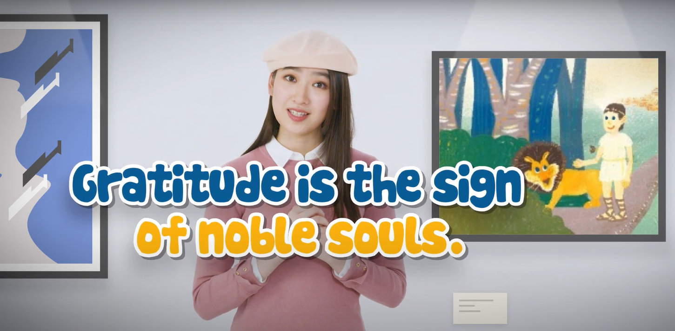
Lesson Plan 2
Through appreciating a story about a slave helping a lion when the lion was in trouble, students are guided to
  understand the meaning of the saying “Gratitude is the sign of noble souls”
  learn about the related positive values and attitudes (e.g. be grateful, be empathetic, care for others)
  write a thank-you card to the person they would like to show appreciation to

Slide 7

Lesson Plan 3
A bird in the hand is
worth two in the bush.
Through watching a video about a shepherd who realised that he should cherish the things he had already had, students are guided to
  understand the meaning of the saying “A bird in the hand is worth two in the bush”
  learn about the related positive values and attitudes (e.g. be grateful, cherish what we have)
  write a reflection on their personal experience

Slide 8
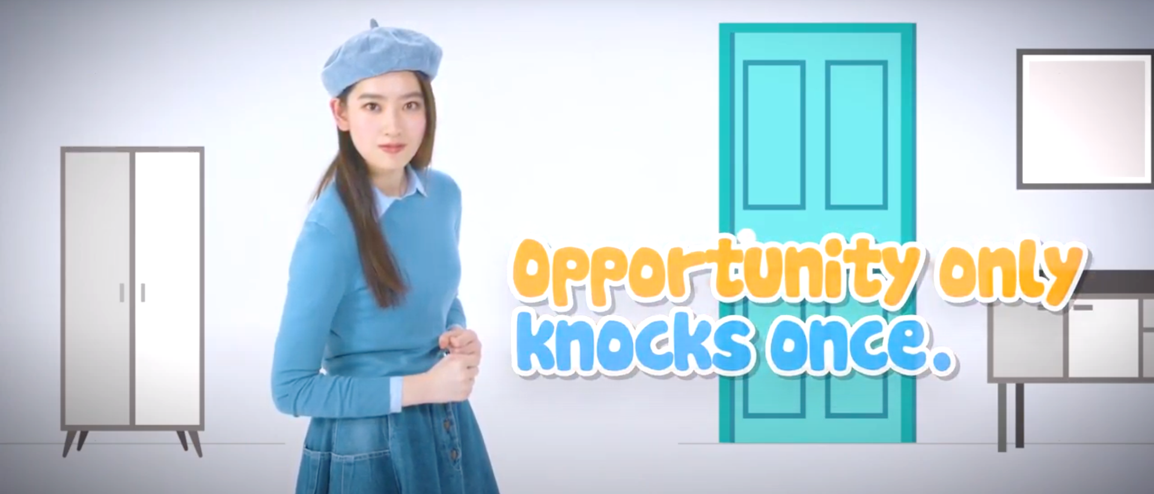
Lesson Plan 4
Through appreciating a story about the different approaches adopted by two men in looking for the treasure in a hidden reef, students are guided to
  understand the meaning of the saying “Opportunity only knocks once”
  learn about the related positive values and attitudes (e.g. be proactive, be positive)
  write a letter to give advice and design a poster to encourage their schoolmates to be proactive

Slide 9

Lesson Plan 5
Through watching a video about a scholar’s determination to publish a new and reliable dictionary, students are guided to
  understand the meaning of the saying “Rome was not built in a day”
  learn about the related positive values and attitudes (e.g. be proactive, be positive, cherish what we have)
  write a reflection on their personal experience

Slide 10

Lesson Plan 6
Through watching a video about an old man who did not seize rare and precious opportunities, students are guided to
  understand the meaning of the saying “Time and tide wait for no man”
  learn about the related positive values and attitudes (e.g. be proactive, be positive, cherish what we have)
  write a reflection on / a recount of their personal experience

Slide 11

Lesson Plan 7
Through appreciating a story about two brother pigs whose houses were attacked by a wolf, students are guided to
  understand the meaning of the saying “A stitch in time saves nine”
  learn about the related positive values and attitudes (e.g. be proactive, be positive, cherish what we have)
  design a poster to promote the message of being proactive

Slide 12

Lesson Plan 8
Through watching a video about three brothers using different ways to achieve the same goal, students are guided to
  understand the meaning of the saying “All roads lead to Rome”
  learn about the related positive values and attitudes (e.g. be positive and optimistic)
  share ideas about how to stay positive and optimistic

Slide 13

Lesson Plan 9
Through appreciating a story about a passionate football player who became a team’s manager after his injury, students are guided to
  understand the meaning of the saying “Every cloud has a silver lining”
  learn about the related positive values and attitudes (e.g. be optimistic and hopeful)
  write a reflection on their personal experience

Slide 14

Lesson Plan 10
Through appreciating a story about a pole vaulter who did not give up challenging the world record in the face of adversity, students are guided to
  understand the meaning of the saying “There is light at the end of the tunnel”
  learn about the related positive values and attitudes (e.g. resilience, perseverance, optimism)
  give a presentation on their personal experience

Slide 15
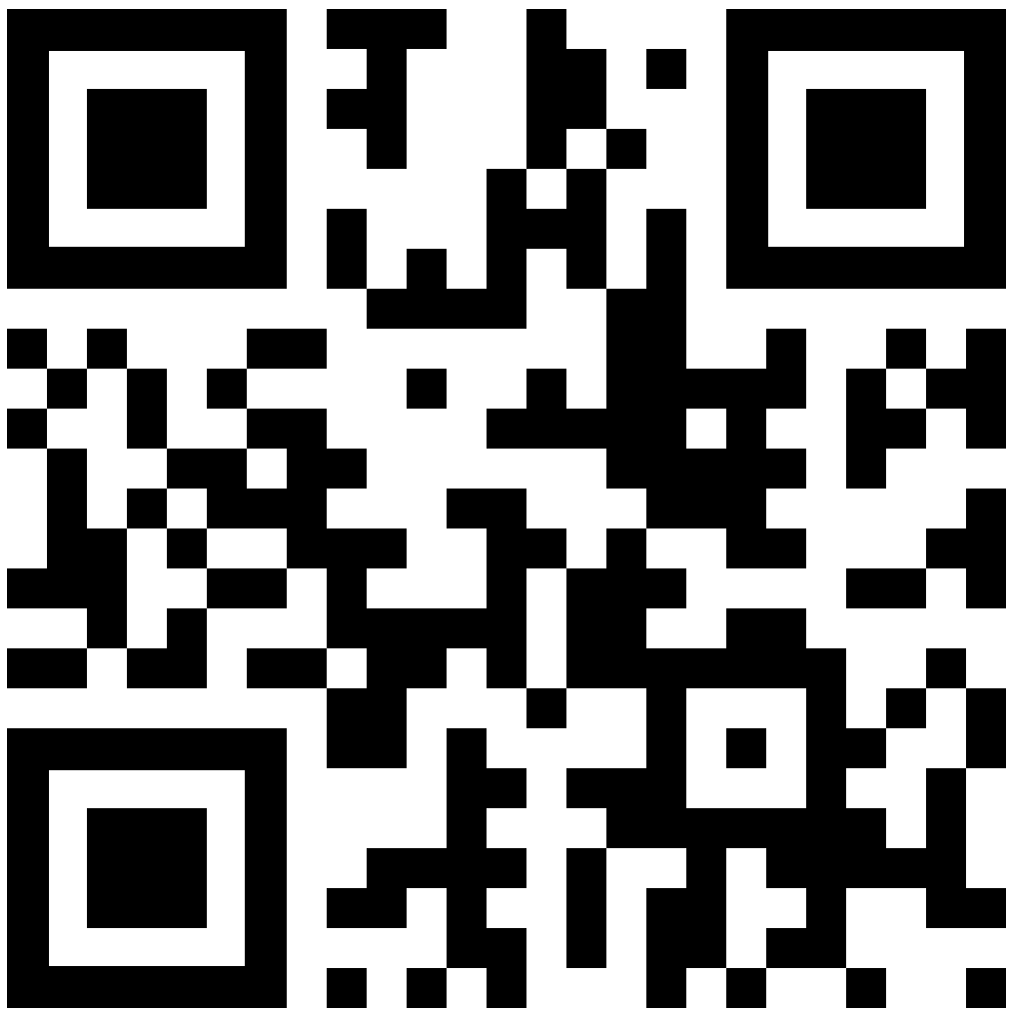
Using the SOWIT Videos Resource Kit in the English Lessons
Tying in with the modules and topics in the school-based English language curriculum, schools are encouraged to make use of the lesson plans in the resource kit to enrich students’ English learning experiences and create an inspiring and engaging environment for the learning and teaching of SOW in the English lessons.
Teachers are encouraged to select and adapt the materials to suit their students’ needs, interests and abilities.
Posters, games, learning and teaching materials and SOWIT videos are available on the website of the Education Bureau (http://www.edb.gov.hk/sow).

